Slide 1
The Hobbit & J.R.R Tolkien
By Lucas Garcia
Next

Slide 2
Teachers
Students

Slide 3
How to Teach this Powerpoint
- For teachers looking to incorporate this powerpoint into a lesson plan here are a few things to know
Make sure you use this powerpoint parallel or after you read the book.
Let students take notes
When letting students take the final quiz allow them to use their notes, it is much more important they pick up the material then just guess.
Collect notes as part of a grade. Parts of the plot and practice quiz require writing thoughts and answers.
Make sure to return notes to the students when your grading is done.
Next

Slide 4
About this PowerPoint
This PowerPoint is built for students in the 9th grade.
Students will be asked to complete a quiz to make sure they looked over the material
Students should be able to complete the quiz with 80% success
Students should be able to view this PowerPoint from anywhere, but the book should be read in class.
Back
Student Powerpoint

Slide 5
Before you Begin!
Turn up the volume please.
Main Menu
Slide 1

Slide 6
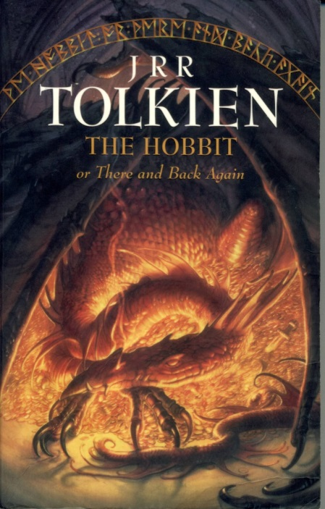
Main Menu
Take the Quiz
J.R.R Tolkien
Practice Quiz
The Hobbit
Pictures From
Click a picture to continue your journey. Or if you have completed your journey, take the quiz!

Slide 7
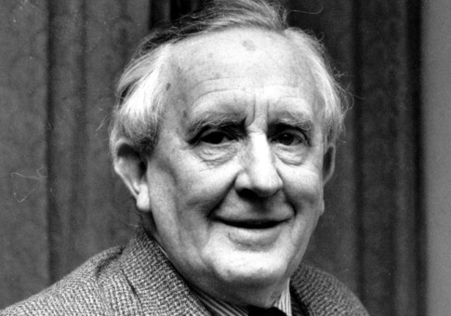
J.R.R Tolkien
Main Menu
Before the author
The Author and Beyond

Slide 8
Before the Author
Born on January 3 1892
At age 16 married Edith Mary Bratt
In 1915 entered World War I
In 1939 he entered WWII, was in both WW
-Started off writing Poetry
JRR Tolkien
Next

Slide 9
The Author and Beyond
-While at Pembroke College worte The Hobbit, and two volumes of The Lord of the Rings
-Tolkien wrote many books, but his most popular is The Lord of the Rings series
-Retired in 1959, so profitable he wish he had retired early
Died in 1971 at age 82
Back
JRR Menu
Next

Slide 10
By J.R.R Tolkien
Publications
Beowulf:The Monsters and the Critics
Childrens books and other short works
The Hobbit
The Lord of the Rings
Silmarillion
Unfinished Tales and The History of Middle-Earth
The children of Hurin
The Legend of Sigurd and Gudrun
Mr.Bliss
JRR Menu
Back
Main Menu

Slide 11
The Hobbit
Main Menu
Characters
Plot

Slide 12
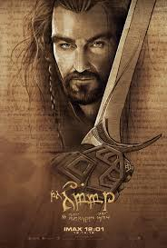
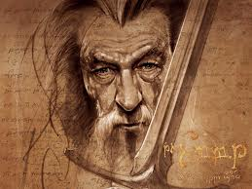
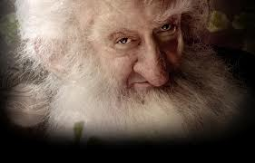
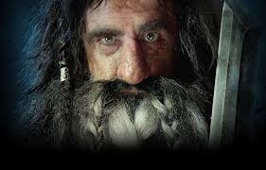
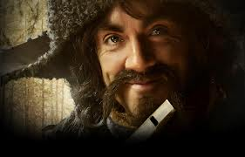
Characters of the Hobbit
Bilbo Baggins
Gandalf
Thorin
Balin
Bifur
Bofur
Main Menu
Hobbit
Next

Slide 13
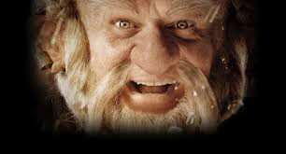
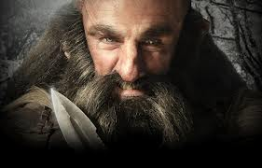
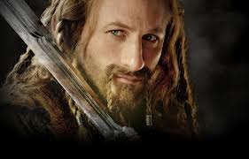
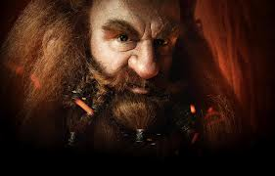
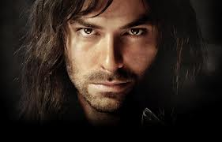
Characters Page 2
Bombur
Dori
Dwalin
Fili
Gloin
Kili
Back
Hobbit
Next

Slide 14
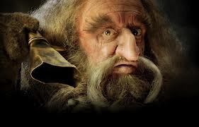
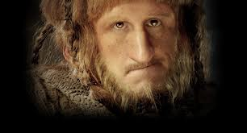
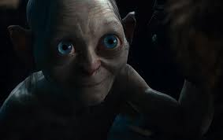
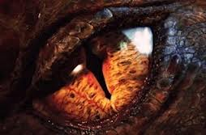
Characters page 3
Nori
Oin
Ori
Gollum
Smaug
Back
Hobbit

Slide 15
Bilbo Baggins
The main character of the Hobbit, and a side character in The Lord of The Rings.
When the Hobbit starts he is 50 years old
Recruited as a thief to help the 13 dwarves
Uses the sword Sting
Gets the One Ring from Gollum after beating him in a game of riddles.
After his adventure he returns to the Shire, and where The Lord of the Rings starts.
Characters
Next

Slide 16
Gandalf
Recruits Bilbo to be the thief.
A wizard
Also known as Gandalf the Grey
Gandalf arranged for the 13 dwarfs and Bilbo to take back the treasure of Erebor from Smaug.
Carries the sword Glamdering, a sword he uses throughout the series.
Was originally going to be named Bladorthin.
Back
Characters
Next

Slide 17
Thorin Oakenshield
The leader of the expedition to take back Erebor
Described as being very talented musically, being able to play the harp and singing.
Gives Bilbo a chain-mail coat made of mithril, one of the strongest metals in Middle earth.
After retaking the mountain, declaired king.
Mortally wounded in the Battle of Five armies.
Back
Characters
Next

Slide 18
Balin
Elder brother of Dwalin
Was a dwarf leader
The second Dwarf to arrive at Bilbo’s house
Second oldest behind Thorin
Only dwarf to volunteer to accompany Bilbo in the secret passage of Smaug
Back
Characters
Next

Slide 19
Bifur
The cousin of Bofur and Bombur
Also musical can play the clarinet Not much else is known about his character…
Characters
Next
Back

Slide 20
Bofur
-Cousin of Bifur and brother of Bombur
-Like his cousin is very good at playing clarinet
-Nearly trapped with his brother by Smaug at the bottom of the Lonely Mountain
Back
Characters
Next

Slide 21
Bombur
The cousin of Bifur and brother of Bofur
Shown to be last in everything an makes many mistakes.
In the book is said to have fallen asleep through many of the key moments in the story
Characters
Back
Next

Slide 22
Dori
He is the brother of Nori and Ori
Dori is described as “a decent fellow despite all of his grumbling”
Called by Thorin as the strongest member of the group
Back
Characters
Next

Slide 23
Dwalin
The younger brother of Balin
Is the very first dwarf to arrive at Bilbo’s house
After the Hobbit he ruled Thorin’s halls in the Blue Mountains
Back
Characters
Next

Slide 24
Fili
He is the brother of Kili and son of Dis, Thorin’s sister
Fell in the Battle of Five Armies
Back
Characters
Next

Slide 25
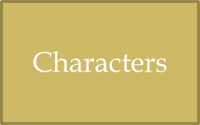
Gloin
Brother of Oin
The father of Gimli, a member of the Fellowship of the Ring.
Was sent with Gimli when to Rivendell about the one ring.

Slide 26
Kili
Is the brother of Fili
Son of Dis, Thorin’s sister
Fell at the Battle of Five Armies protecting Thorin

Slide 27
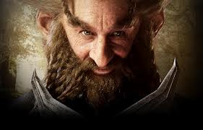
Nori
Is the brother of Ori and Dori
Wears a purple hood
Not much else is known about this character

Slide 28
Oin
Is the brother of Gloin
Counted on to start camp fires
Wears a brown hood
Killed by a creature known as “The Watcher in the Water” after the Hobbit

Slide 29
Ori
He is the brother of Dori and Nori
Wears a grey hood
Loves the arts
One of the last Dwarfs to be killed in Moria
Wrote the book of Mazarbul, a book later found by the Fellowship

Slide 30
Gollum
Originally known as Smeagol, before being corrupted by the One Ring
Refers to the One Ring as “precious”
Loses to Bilbo in a game of riddles
Loses the One Ring later picked up by Bilbo Baggins
Plays a huge part in The Lord of the Rings Trilogy outside of just The Hobbit

Slide 31
Smaug
One of the last dragons of Middle Earth
After destroying Dale takes over the Lonely Mountain, also known as Erebor
The journey of the Hobbit is to retake the mountain from Smaug
He is killed after being shot with an arrow in a weak spot on the left side of his chest
Was also called Smaug the Golden since he slept on top of a pile of gold.

Slide 32
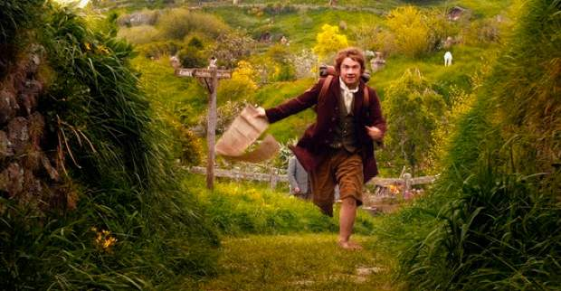
The beginning
Gandalf ask Bilbo to host a house party
Bilbo meets 12 dwarves who are looking to reclaim the Lonely Mountain from Smaug.
Bilbo is then asked to be the thief and help on the journey
Despite Bilbo being unsure at first, he goes with them and begins his adventure
Write! What stood out to you? Something here or something else mentioned? Write it on your paper!
Main Menu
Next

Slide 33
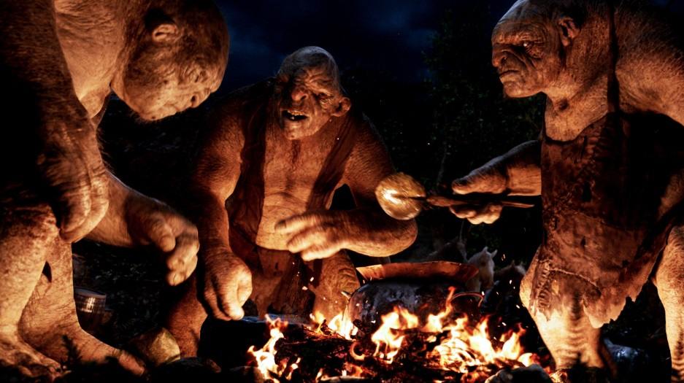
Trouble ensues!
The group runs into three trolls who want to eat them
Goblin tunnel where Bilbo gets lost from the rest of the group.
The group then comes across giant spiders in the forest of Mirkwood
Most of these moments are very closely tied together, the group gets into a lot of trouble, but always seems to get out of it. Which do you think was the hardest for them to get out of?
Back
Next

Slide 34
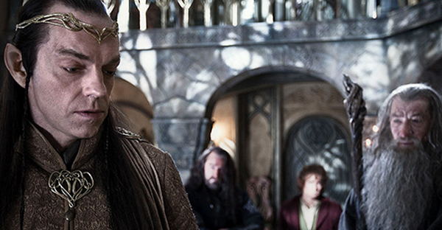
The middle
After being saved by Gandalf against the trolls the group makes its way to Rivendell
There Elrond helps them revealing more about the secret entrence to the Lonely Mountains
After leavining they go over the Misty Mountains where they are captured by goblins.
Bilbo manages to escape and meets a strange creature.
After leaving the goblin cave Bilbo rejoins and they head for Mirkwood.
After meeting Giant spiders they are soon close to the Lonely Mountains, where they hope to take down Smaug once and for all.
Forward
Back

Slide 35
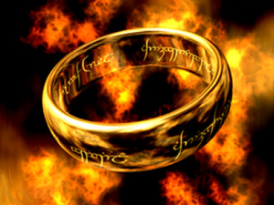
The tie to The Lord of The Rings
Bilbo gains many items that also find there way to Frodo, the hero of The Lord of the Rings
Bilbo gains the One Ring after finding it in Gollums cave. After beating Gollum in a game of riddles he manages to escape with it.
Bilbo finds Sting along with other swords that are carried by his companions
Bilbo is given a mythril vest from Thorin after Smaug is killed
Which of these items would you most like to have if given the choice?
Back
Next

Slide 36
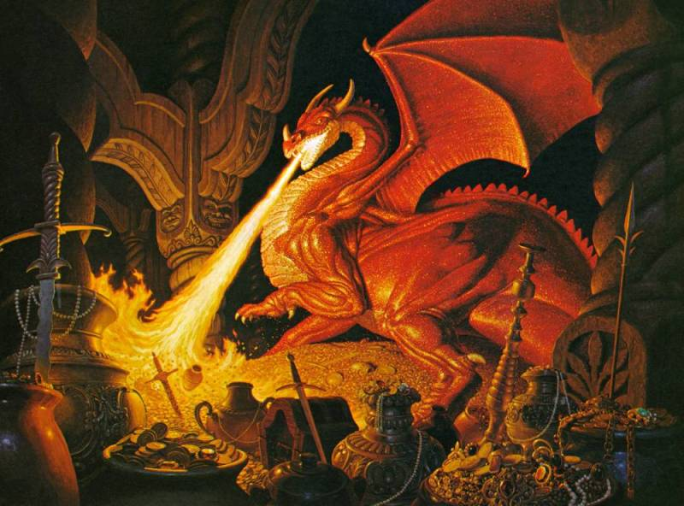
The End
After reaching the Lonely Mountains Bilbo goes into the secret entrance
While in there he meets Smaug and see’s he has a missing Scale
After Smaug is awakened a man named Bard kills Smaug with an arrow.
The dwarves take over the mountain, but the elves want to take it from them
After goblins show up the elves, and dwarves make up and fight along side each other
Thorin is wounded in this battle called the Battle of Five Armies
After this Bilbo returns to the Shire with treasure
Write: What did you think of this ending? Was it handled well? If you could change it would you, and how so?
Main Menu
Practice quiz
Back

Slide 37
Practice Quiz
This Quiz will consist of 5 questions that are Fill in the Blank. You can use your Notes.
Note: This is to see how well you took notes,, which you can use on the final quiz.
Main Menu
Next

Slide 38
PQ: Question 1
What is the Name of J.R.R Tolkiens Wife, and what age did they marry?
Check Answer

Slide 39
Answer!
The answer was Edith Mary Bratt at age 16
You can find this answer on the Slide of J.R.R Tolkien before the author
Next Question
Back to question

Slide 40
PQ:Question 2
- In What Year Did J.R.R Tolkien retire?

Slide 41
Answer
He reitired in the year 1959
You can find this answer on the slide “The author and Beyond

Slide 42
Question 3
What was the original name for Gandalf supposed to be?

Slide 43
Answer
His original name was supposed to be Bladorthin.
You can find this answer on the Gandalf character slide

Slide 44
PQ: Question 4
Thorin is good at playing what musical instrument?

Slide 45
Answer
Thorin is good at playing the Harp
You caqn find this answer on the Thorin Character Slide

Slide 46
PQ: Question 5
- How does Bilbo Gain The One Ring?

Slide 47
Answer
- Beat Gollum at a game of Riddles
Back to Practice
Quiz

Slide 48
Quiz
Welcome to the Main Quiz Here you will be tested on how well you viewed the material Remember you can use your notes.
On this quiz you will have 5 True/ False and 5 Multiple Choice. Good Luck!
Main Menu
First Question

Slide 49
Question 1
J.R.R Tolkien was in Both World Wars?
True
False

Slide 50
Question 2
What was not a Gift Bilbo got from his adventure?
Sword named Sting
Mythril Vest
The One Ring
Gold armor

Slide 51
Question 3
The Dwarfs are the ones who ultimately kill Smaug
True
False

Slide 52
Question 4
Which is not a book J.R.R Tolkien Wrote
A) Beowulf:The Monsters and the Critics
B) Creatures of Middle Earth
C)Childrens books and other short works
D) The Silmarillion

Slide 53
Question 5
Smaug is nicknamed Smaug the Rich?
True
False

Slide 54
Question 6
Gollum goes by what name before being called Gollum?
A) Smeagol
B)Deagol
C) Samwise
D) Reagol

Slide 55
Question 7
Thorin is Killed by Smaug?
True
False

Slide 56
Question 8
What does the group never come across on their journey?
A) Trolls
B) Goblins
C) Nazgul
D) Spiders

Slide 57
Question 9
J.R.R Tolkien dies in what year?
1969
1971
1973
1975

Slide 58
Question 10
Bilbo is called the Spy of the group?
True
False

Slide 59
Correct
Next Question

Slide 60
Correct

Slide 61
Correct

Slide 62
Correct

Slide 63
Correct

Slide 64
Correct

Slide 65
Correct

Slide 66
Correct

Slide 67
Correct

Slide 68
Correct
Main Menu

Slide 69
Incorrect
Go back to the question

Slide 70
Incorrect

Slide 71
Incorrect

Slide 72
Incorrect

Slide 73
Incorrect

Slide 74
Incorrect

Slide 75
Incorrect

Slide 76
Incorrect

Slide 77
Incorrect

Slide 78
Incorrect

Slide 79
Pictures courtesy of these sites
Main
http://jkinak04.files.wordpress.com/2013/02/j-r-r-tolkien1-1.jpg
http://specials-images.forbes.com/imageserve/06yh7ds0Qsf2h/0x600.jpg?fit=scale&background=000000
http://news.bbcimg.co.uk/media/images/63521000/jpg/_63521342_tolkien.jpg
http://blogs.slj.com/afuse8production/files/2012/06/Hobbit9.jpg
http://therealmcast.com/wp-content/uploads/2011/01/the-hobbit-2011.jpg
http://images.wikia.com/lotr/images/a/a4/Bilbo_Baggins_%282%29.jpg
http://www.google.com/url?sa=i&rct=j&q=&esrc=s&source=images&cd=&docid=5Pbqc5FywRhf7M&tbnid=A_HplMPTDXQlwM:&ved=0CAIQjBw&url=http%3A%2F%2Fwallpaperstock.net%2Fthe-hobbit-gandalf-artwork_wallpapers_35442_1600x1200.jpg&ei=V5huUazsKIKxywGh1IDIAg&bvm=bv.45368065,d.aWc&psig=AFQjCNGdBJFFiB9yZhicHgRMm5uXLD0sPw&ust=1366288853690256
http://i1115.photobucket.com/albums/k546/Dave_Lewis/thorin.jpg
http://2.bp.blogspot.com/-L2lxyniKs0k/ULZMkG8RJ1I/AAAAAAAABrs/Qh4JiBJSJI4/s1600/Balin+dwarf+The+Hobbit.jpg
http://3.bp.blogspot.com/-VcKDsohCNkM/ULfdv7o8l7I/AAAAAAAABtk/j9ZNGzxAGH0/s1600/Bifur+dwarf+The+Hobbit+Wallpaper.jpg
http://1.bp.blogspot.com/-Sry5o1tjnKg/ULjCZSmsR1I/AAAAAAAABvc/u8Nus8AWWT0/s1600/Bofur+dwarf+The+Hobbie+Wallpaper.jpg
http://2.bp.blogspot.com/-5ceLSgcYl64/ULojG_e-zcI/AAAAAAAABxU/87XcehoiDzo/s1600/Bombur+dwarf+The+Hobbit+Wallpaper.jpg
http://3.bp.blogspot.com/-RK-Tg7po2VY/ULv6cwzPJfI/AAAAAAAABzU/tCJepajB734/s1600/Dori+dwarf+The+Hobbit+Wallpaper.jpg
http://2.bp.blogspot.com/-QDODLffQcrQ/ULzGifp-pmI/AAAAAAAAB1M/npPGUDVSzhc/s1600/Dwalin+dwarf+the+Hobbit.jpg
http://www.google.com/imgres?imgurl=http://images6.fanpop.com/image/photos/33400000/Fili-Wallpaper-fili-and-kili-33416116-1500-960.jpg&imgrefurl=http://www.fanpop.com/clubs/fili-and-kili/images/33416116/title/fili-wallpaper-photo&h=960&w=1500&sz=220&tbnid=qgIk8hG08dlvnM:&tbnh=90&tbnw=141&zoom=1&usg=__2gR-no6CQSxRt153dVUF7B0A3Ig=&docid=ChQBLmPOmgbz8M&sa=X&ei=UpluUbnyEuiFywHShYGwCA&ved=0CD4Q9QEwAw&dur=246
http://4.bp.blogspot.com/--d_mMyUrW6Q/UL9-jmju6sI/AAAAAAAAB84/xK4T_72GiJY/s1600/Gloin+dwarf+The+Hobbit.jpg
http://4.bp.blogspot.com/-oFtV46rdofQ/UMDx6c9EctI/AAAAAAAAB-4/OWdWHKve6Jg/s1600/Kili+dwarf+Wallpaper.jpg
http://1.bp.blogspot.com/-HZf-aBKupWo/UMHtlnxByqI/AAAAAAAACGE/Hok2lEhKlTw/s1600/Nori+dwarf+The+Hobbit+Wallpaper.jpg
http://4.bp.blogspot.com/-FKe_6eR3pb4/UMS3KUD6aqI/AAAAAAAACIU/wHFRZppK544/s1600/Ori+dwarf+The+Hobbit.jpg
http://3.bp.blogspot.com/-UTYugTlqIa8/UMN4tntjvzI/AAAAAAAACIE/JEHEJf7aRAE/s1600/Oin+dwarf+The+Hobbit+Wallpaper.jpg
http://tdzdaily.org/wp-content/uploads/2013/01/The-Hobbit-Gollum.jpg
http://images2.wikia.nocookie.net/__cb20070505180157/lotr/images/2/2d/Smaug%27s_Treasure.jpg
http://heirsofdurin.files.wordpress.com/2013/01/smaug.jpg?w=318&h=209
http://images.wikia.com/lotr/images/7/78/Bilbo_Baggins.jpg
http://www.badhaven.com/wp-content/uploads/2012/07/hobbit7220123.jpeg
http://noellecampbelldotcom.files.wordpress.com/2012/12/the-one-ring-lotr.jpg?w=300&h=225
http://images3.wikia.nocookie.net/__cb20130411232014/lotr/images/6/6b/Hobbler-trolls.jpg

